Slide 1
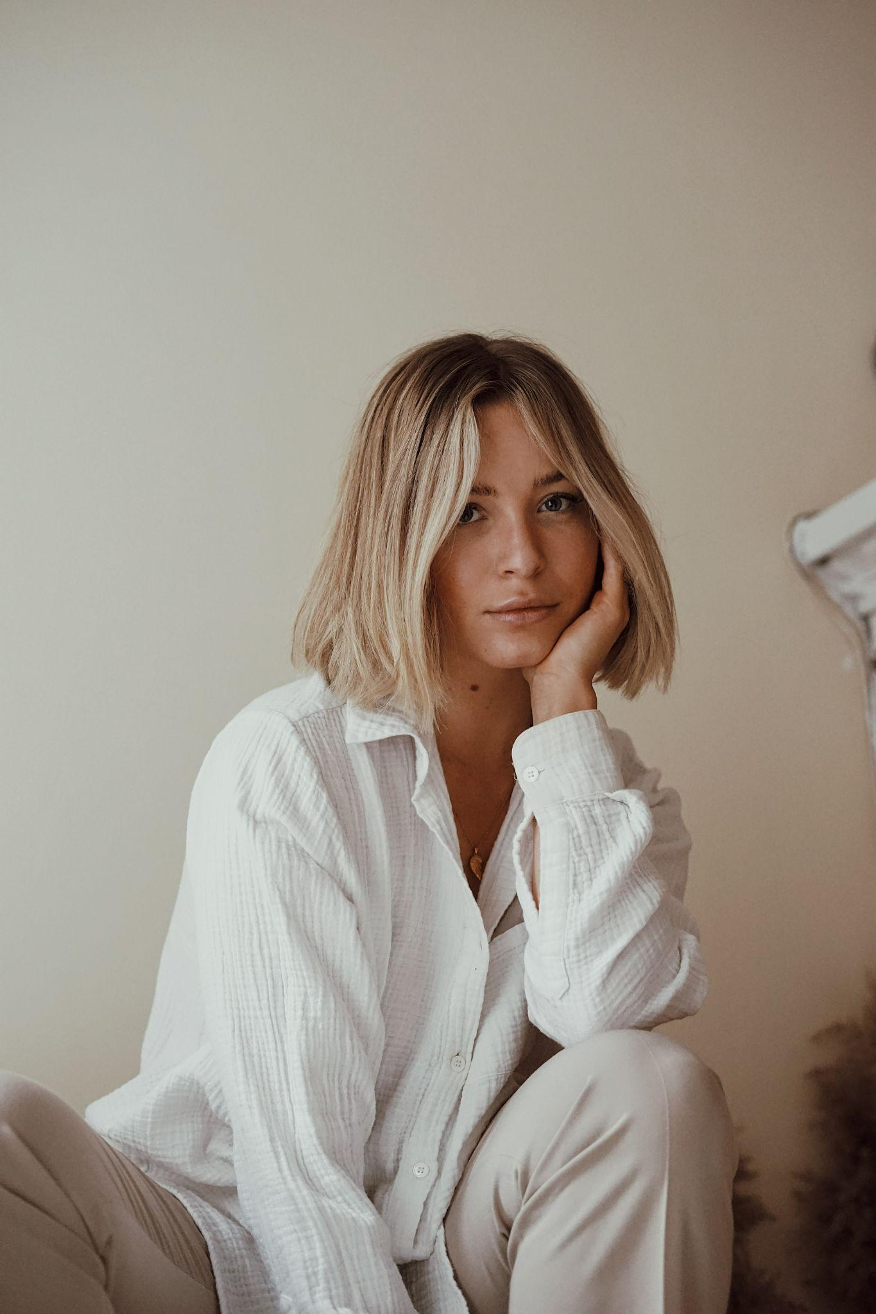
“I am very selective when it comes to books I read and promote in my blogs or posts so it’s really difficult for me to pick a book ”
Add image that represents this persona
Goals
Want an idea about what a book can offer before purchase
Find books based on genre
Save my time while searching for books
Frustrations
Good recommendations are hard to find
Confusing to choose which books to be selected
Hailey
Hailey is a 25 year old influencer who loves to wind up the day in comfortable PJs and a good book. Selecting an interesting and insightful book is important to her as it motivates her and helps her bring more insights into what she does. She also needs good recommendations on books as she often gives her audience her views on books and what she learned from it.
Age:
Education:
Hometown:
Family:
Occupation:
25
BA
California
Parents, 1 sibling
Influencer,
Graphic Designer

Slide 2
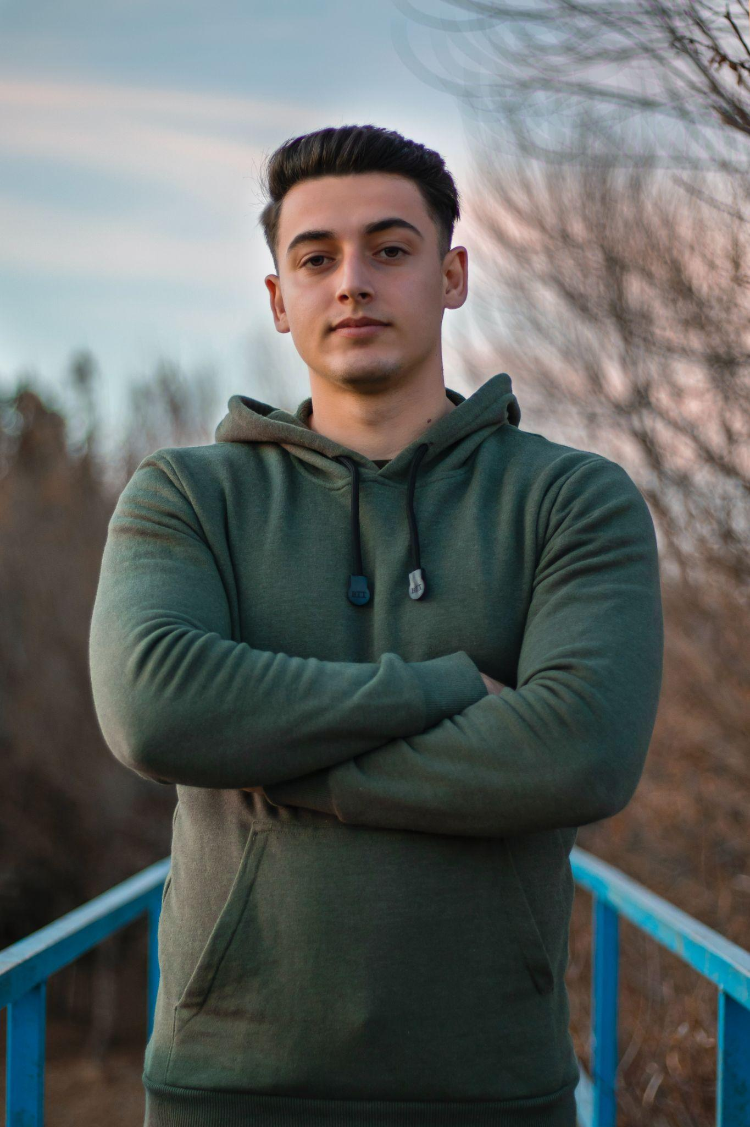
“Books help me be interesting.Any quick way to get wholesome, fascinating books online will be such a help”
Add image that represents this persona
Goals
Finding new books/ authors to read
Get recommendations on currently trending books
Receiving books quickly
Have audio-book options as well
Frustrations
Misses seeing people’s reviews on the book
Finds keeping track of different series or author hard
Wants a way to bookmark a book for the future purchase
Dan
Dan is 28 years old working at an advertising firm. He loves to go out and meet people and thinks that books help in making conversations interesting. He wants to be up to date on all the trending books so that he can make new friends/ be interesting in dates. He also wants an option to buy audio books so that he can listen while on commute.
Age:
Education:
Hometown:
Family:
Occupation:
28
BA
Washington
Parents, lives alone
Working in advertising firm

